Slide 1

CUSTOMER SEGMENTATION USING K-MEANS CLUSTERING
DONE BY : SYED ALEEM
INSTITUTE : EXPOSYS DATA LABS

Slide 2
CONTENTS
INTRODUCTION
SEGMENTATION IS AN ONGOING PROCESS TO MANAGE THE CUSTOMER BASE
NEED OF CUSTOMER SEGMENTATION
K-MEANS CLUSTERING
WHAT K-MEANS DOES
STEPS OF K-MEANS CLUSTERING
CHOOSING THE RIGHT NUMBER OF CLUSTERS
THE ELBOW METHOD
CONCLUSION

Slide 3
INTRODUCTION
Customer segmentation is a method of dividing customers into groups or clusters on the basis of common characteristics.
The market researcher can segment customers into the B2C model using various customer's demographic characteristics such as occupation, gender, age, location, and marital status.
Psychographic characteristics such as social class, lifestyle and personality characteristics and behavioural characteristics such as spending, consumption habits, product/service usage, and previously purchased products.
In the B2B model using various company's characteristics such as the size of the company, type of industry, and location.

Slide 4
SEGMENTATION is an ongoing process to manage the customer base
A segment is a group of customers who display similar attributes to each other...
They may react similarly in a product/service offering
They may provide comparable values (profitability) to the company
They may bear the same needs or behave in alike ways.
There is no one right way to segment (not should there be)
Many different approaches and techniques
Choosing an approach requires a mix of art, science, common sense, experience and
practical knowledge
Also depends on market, business needs, availability of data
The aim is not necessarily to build one holistic model to meet all needs, several
models used in conjunction with each other can work well.

Slide 5
Need of customer segmentation
It will help in identifying the most potential customers.
It will help managers to easily communicate with a targeted group of the audience.
Also, help in selecting the best medium for communicating with the targeted segment.
It improves the quality of service, loyalty, and retention.
Improve customer relationship via better understanding needs of segments.
It provides opportunities for upselling and cross-selling.
It will help managers to design special offers for targeted customers, to encourage them to buy more products.
It helps companies to stay a step ahead of competitors.
It also helps in identifying new products that customers could be interested in.

Slide 6
K-MEANS CLUSTERING
Clustering or cluster analysis is an unsupervised learning problem. It is often used as a data analysis technique for discovering interesting patterns in data, such as groups of customers based on their behaviour.
There are many clustering algorithms to choose from and no single best clustering algorithm for all cases.
K-Means clustering is an unsupervised learning algorithm that, as the name hints, finds a fixed number (k) of clusters in a set of data.
A cluster is a group of data points that are grouped together due to similarities in their features.

Slide 7
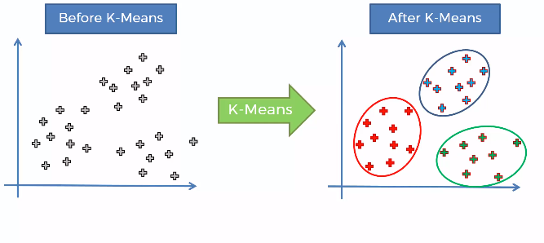
What k-means does

Slide 8
STEPS OF K-MEANS CLUSTERING
STEP 1: Choose the number of K clusters.
STEP 2: Select at random K points, the centroid (not necessarily from the data set).
STEP 3: Assign each data point to the closest centroid, that forms K clusters.
STEP 4: Compute and place the new centroid of each cluster.
STEP 5: Reassign each data point to the new closest centroid.
If any reassignment took place, go to STEP 4, otherwise go to finish.

Slide 9
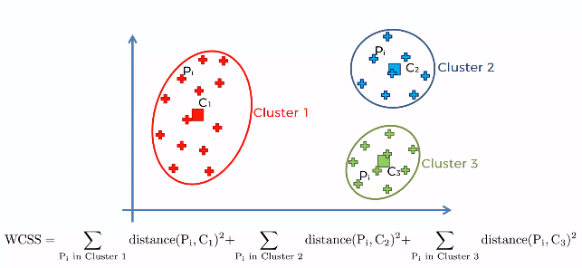
CHOOSING THE RIGHT NUMBER OF CLUSTERS

Slide 10
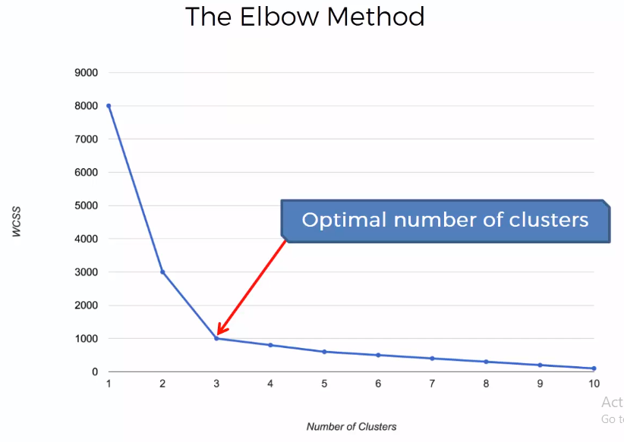
THE ELBOW METHOD
The elbow method runs k-means clustering on the dataset for a range of values for k (say from 1-10) and then for each value of k computes an average score for all clusters.
By default, the distortion score is computed, the sum of square distances from each point to its assigned center.

Slide 11
CONCLUSION
K means clustering is one of the most popular clustering algorithms and usually the first thing practitioners apply when solving clustering tasks to get an idea of the structure of the dataset. The goal of K means is to group data points into distinct non-overlapping subgroups. One of the major application of K means clustering is segmentation of customers to get a better understanding of them which in turn could be used to increase the revenue of the company.

